Slide 1
Quantitative Methods Lecture-2

Slide 2
Organizing and Visualizing Variables
(Ch 2 & 3 Business Statistics, Levine et al.)

Slide 3
So far and the next
Session 1:
Defining and collecting data
Survey and sampling methods
Session 2:
Organizing and visualizing variables
Ch 2 & 3 Business Statistics, Levine et al.

Slide 4
Focus and mode
Concept clarity
Ability to apply concepts
Everything should flow from your business or managerial questions
Active participation and discussions

Slide 5
Why organize?
Start with the business question
Making sense of the data
Tabular presentation makes it easier to grasp data by features/variables
Summary of important variables can be easily seen
Max, min, spread, averages etc.
Variable relationships can be explored
Errors can seen
Data can be explored systematically
Global summaries and drilling down
From Raw data
To organized

Slide 6
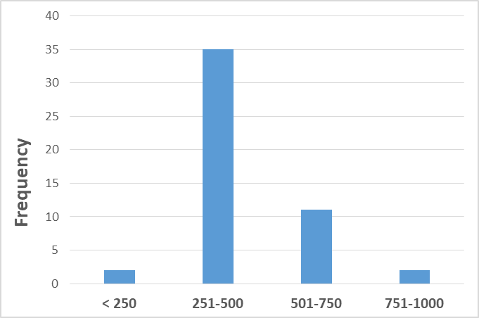
Why picturize?
From Raw data
Visual summary helps
Tabular data can be overwhelming
May have millions of rows and hundreds of columns
A visual summary can be revealing
Spread
Distribution
Relationships
Trends
To pictorial presentation

Slide 7
What are we organizing or picturizing?
A variable or a set of variables together
Variable type decides what all we could do
Can we find average of categorical variables?
For gender variable, which takes two values: Male or Female
Frequency or proportion makes more sense
For height of the class
Max, min, spread and average etc. would make sense

Slide 8
Variables
From the previous session
Categorical
Numerical
More nuanced categorization
Based on scales
Nominal (categorical)
Ordinal
Interval
Ratio
What is a “scale”? (Please type your answers in the chat box)

Slide 9
Variables
Categorical
Numerical
Based on scales
Nominal (categorical)
Ordinal
Interval
Ratio

Slide 10
1. Nominal scale
Nominal (from ‘name’), also called Categorical variable.
Engineer?- Yes/No.
Gender- Male/Female.
Material- Wood/Metal/Plastic/Steel/Bronze.
Industry- Oil/Mining/Automobile/Media/IT/Food processing.
Etc.
Measurements
Data can be categorized and counted; cannot be measured or ranked.

Slide 11
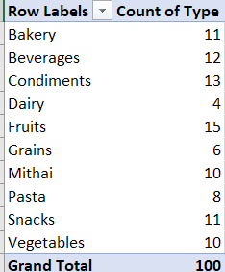
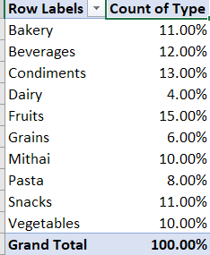
Nominal data- frequency and proportion table
Store inventory data
Microsoft Spreadsheet
Insert
Pivot table
Recommended
Select entire table
Start with blank table
Add type to rows and values
Value field settings can be changed to % of column as well
You can work with multiple variables together by adding them to rows or columns

Slide 12
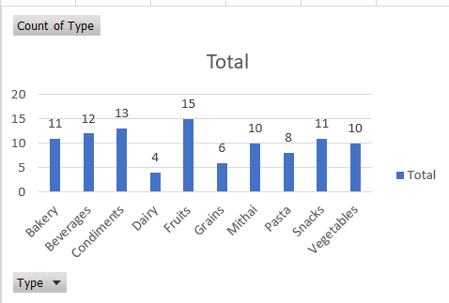
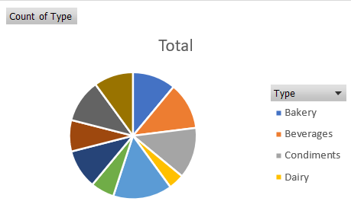
Nominal data- bar charts and pie charts

Slide 13
Variables
Categorical
Numerical
Based on scales
Nominal – Frequency, percentages, bar and pie charts
Ordinal
Interval
Ratio

Slide 14
2. Ordinal data
Ordinal (from ‘Order’), also called Ranked data.
Tall, taller, tallest.
Big, bigger, biggest.
Olympics: First, second, third, fourth….
Thickness: very thick, thick, thin.
Taste: Good, average, below average, bad.
Temperature: freezing, cool, warm, hot.
Customer satisfaction: not satisfied, somewhat satisfied, satisfied, highly satisfied.
What we could do with ordinal data?
Nominal
+ Data can be ranked

Slide 15
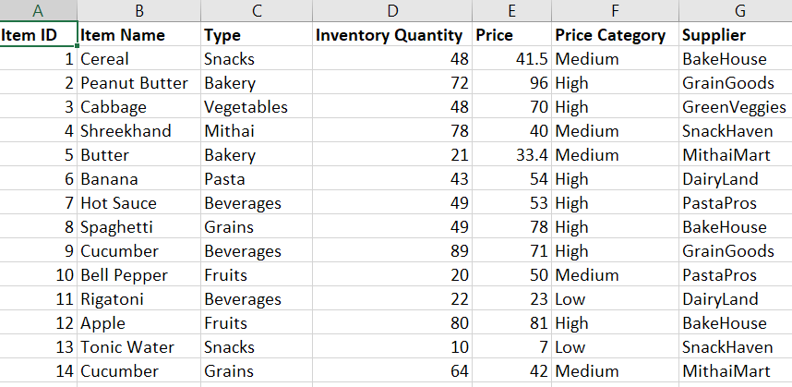
Ordinal data
Price category:
Low: 0-25
Medium: 26-50
High: >50
fr: Year-1 Fresher

Slide 16
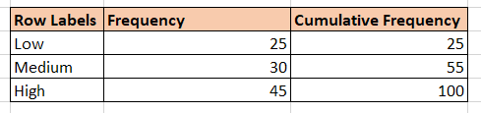
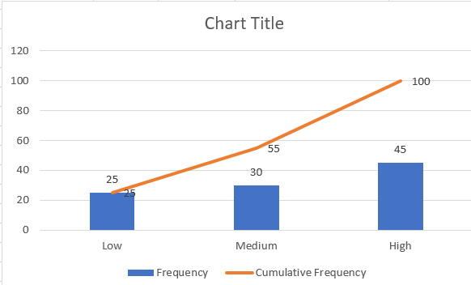
Ordinal data- Frequency & Cumulative frequency table & Ogive chart
Ogive is
cumulative
frequency
line
In Microsoft spread sheet
Choose the data and select
Custom combo chart
Bars for frequency &
Add a line for cumulative frequency

Slide 17
Variables
Categorical
Numerical
Based on scales
Nominal – Frequency, percentages, bar and pie charts
Ordinal – Nominal + cumulative frequency charts
Interval
Ratio

Slide 18
Interval scale
Numerical data, where zero is arbitrary chosen.
Intervals/differerence between two points make logical sense
Temperature measured in Centigrade.
Temperature measured in Fahrenheit.
Employee satisfaction measured on 1 to 7 scale
‘ 1 2 3 4 5 6 7
Not satisfied Highly satisfied
Customer satisfaction measured on 1 to 5 scale
‘ 1 2 3 4 5
Zero is arbitrary chosen-
Zero degree Centigrade/Fahrenheit is not zero temperature
Zero Kelvin is 0 temperature

Slide 19
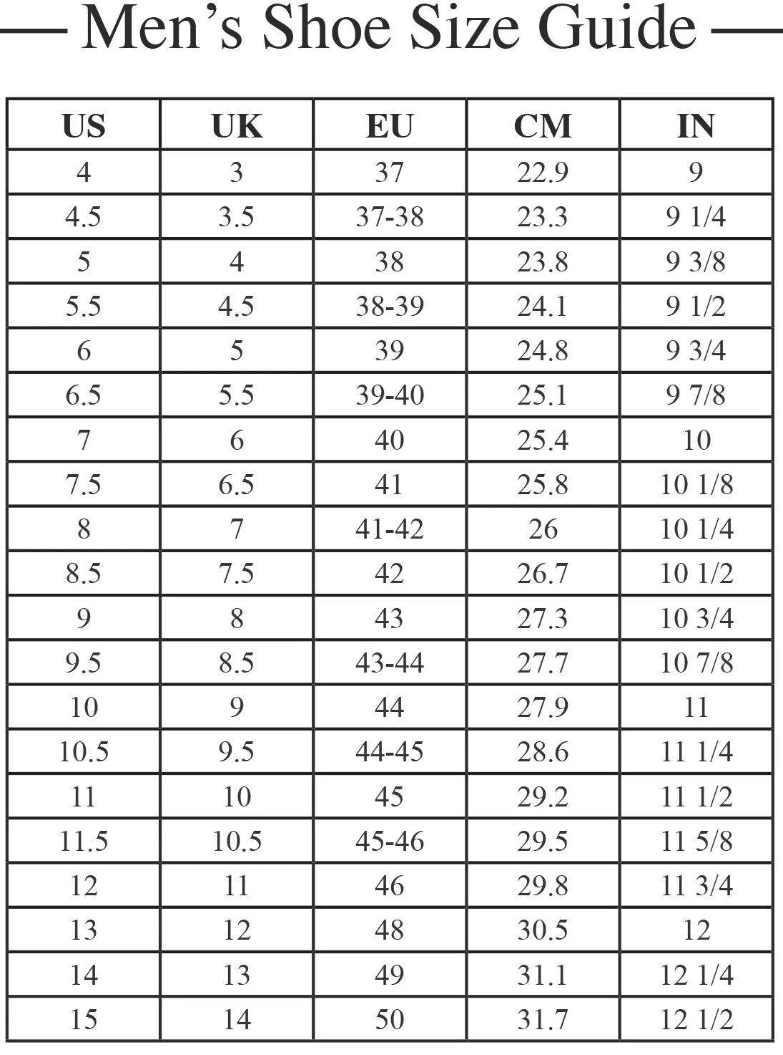
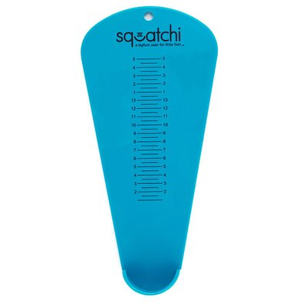
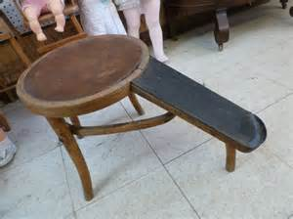
US/UK/EU shoe sizes are on Interval scale-because their zero size will not be of zero length
Garment sizes may also be on Interval scale.

Slide 20
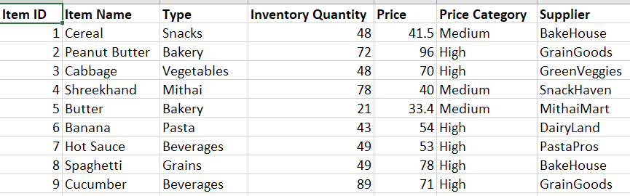
Interval data
What we could do with ordinal data?
Ordinal
+ Data Distribution, Histograms

Slide 21
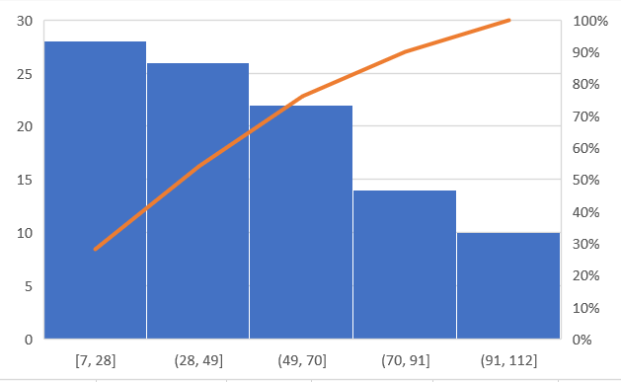
Interval data- Histogram, Cumulative frequency
Fig: Histogram of number of products by price buckets (bins) (Store Inventory Data)

Slide 22
Variables
Categorical
Numerical
Based on scales
Nominal – Frequency, percentages, bar and pie charts
Ordinal – Nominal + cumulative frequency charts
Interval - Ordinal + Distribution chart (histogram)
Ratio

Slide 23
Ratio scale
Numerical data, Zero means no value
Height in mm/cm/m
Weight in g/kg/tons
Time in sec/min/hr
Temperature in Kelvin
Humidity in %
Sales (nos, tons, or Rs)
Charts
Same as interval scale

Slide 24
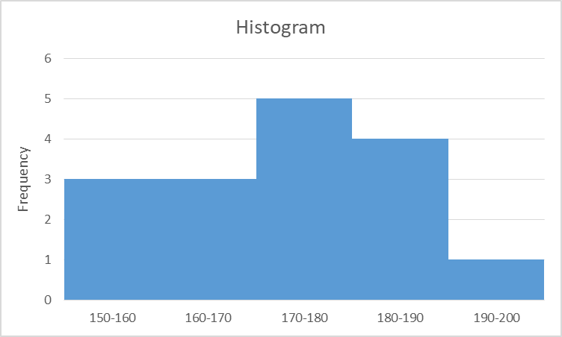
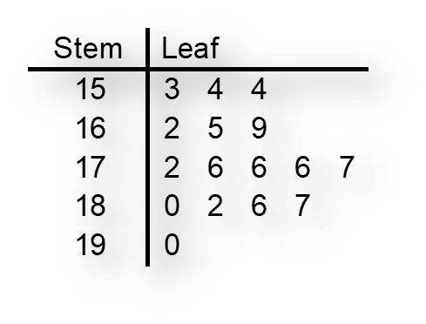
Ratio scale charts
Stem-and-Leaf diagram is like a histogram, without losing the data.
Rotate this table by 90º.

Slide 25
Two variables- tables and charts

Slide 26
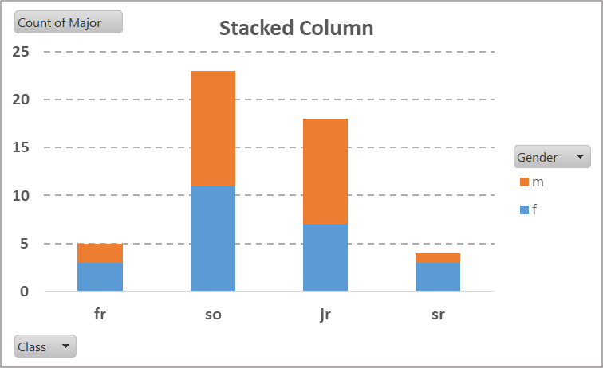
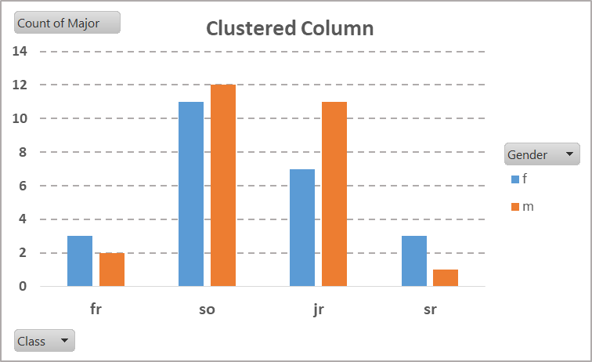
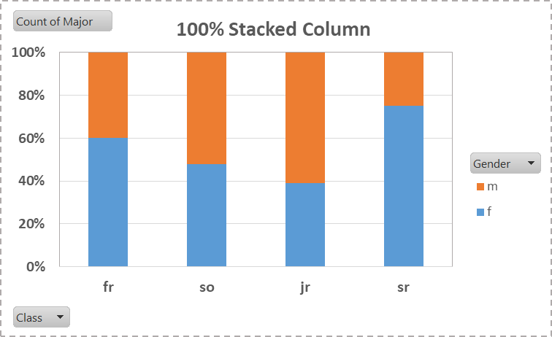
Two or categorical variables- Column charts
Two variables are- Gender (f/m) and Class (fr, so, jr, sr).

Slide 27
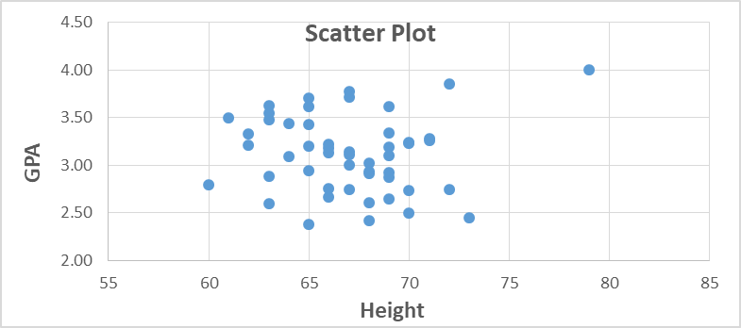
Two numerical variables- Scatter plot
Two variables are- Height and GPA.

Slide 28
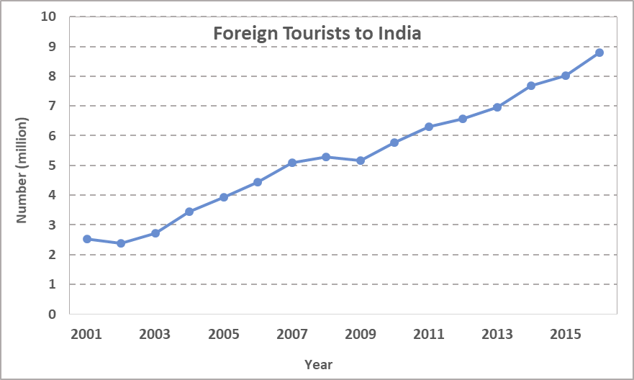
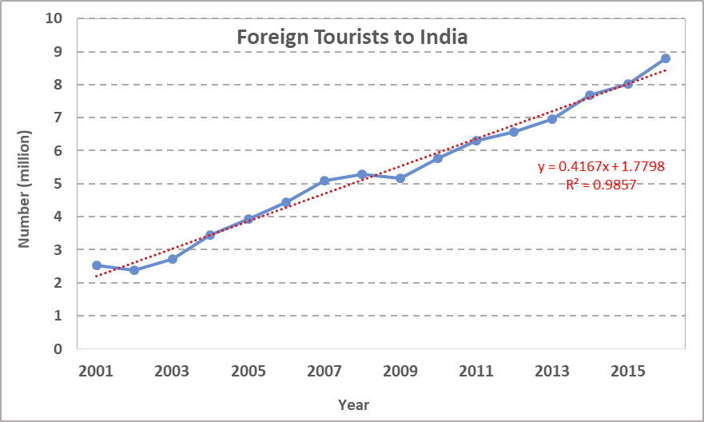
Two variables- Line chart
Two variables are- Year and Tourists .

Slide 29
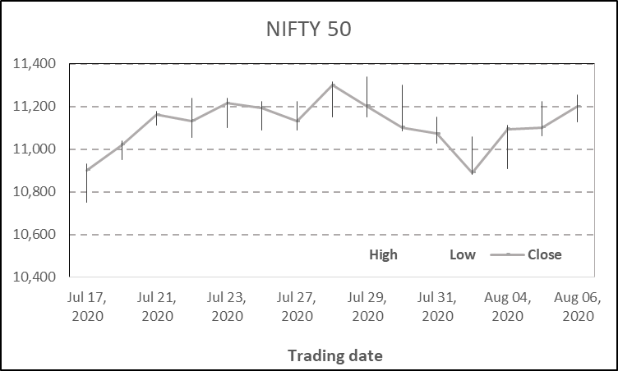
Two or more variables- Stock chart
Three variables are- High, Low and Close prices.

Slide 30
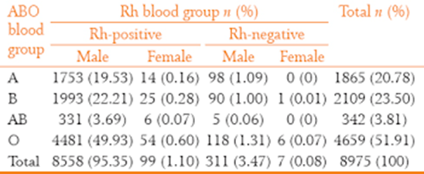
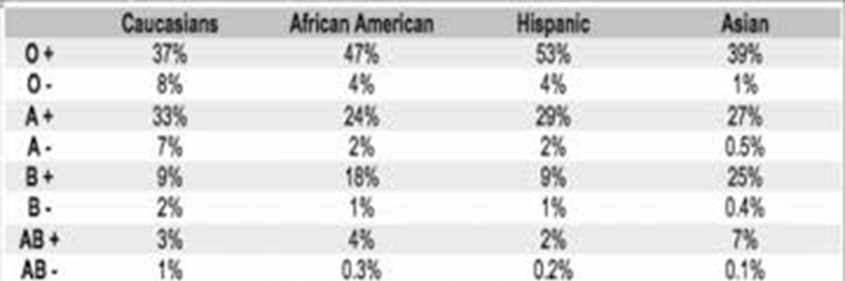
Summary tables- One, Two, and Three variables
Frequency table
One nominal variable- Blood Group
Contingency table
Three nominal variables- Blood group, Gender and Rh
Contingency table
Two nominal variables- Blood Group and Ethnicity

Slide 31
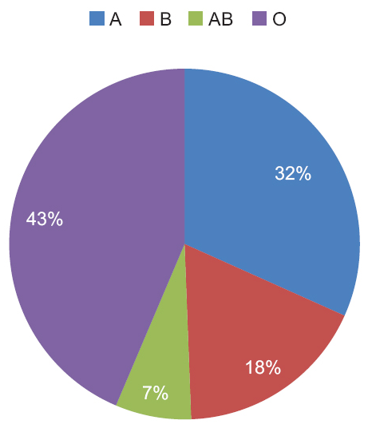
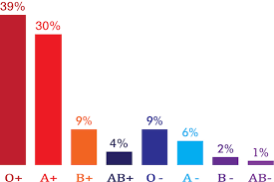
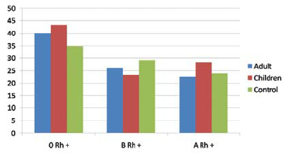
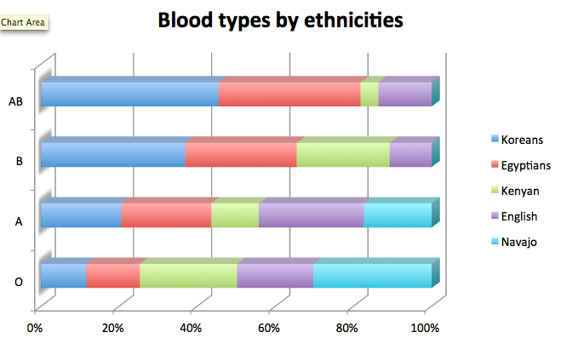
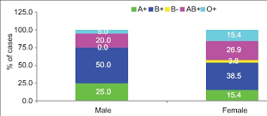
Visual representation- charts
1
2
3
1 Pie chart
2 Column chart
3 Side-by-side chart
4 Stacked row chart
5 Stacked column chart
4
5

Slide 32
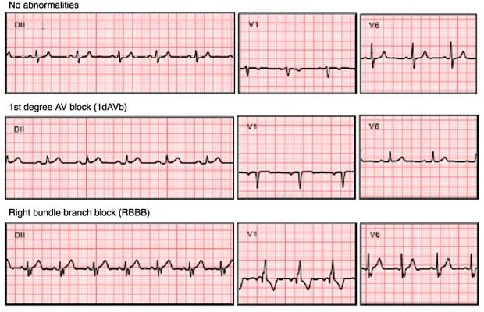
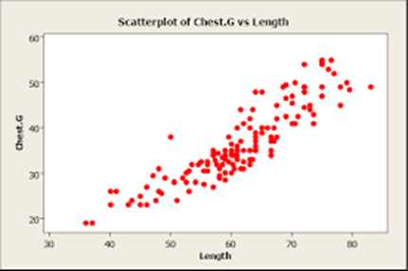
Two variable- charts
Time Series chart Scatter plot (Chest-G vs. Length)

Slide 33
Q&A

